Slide 1
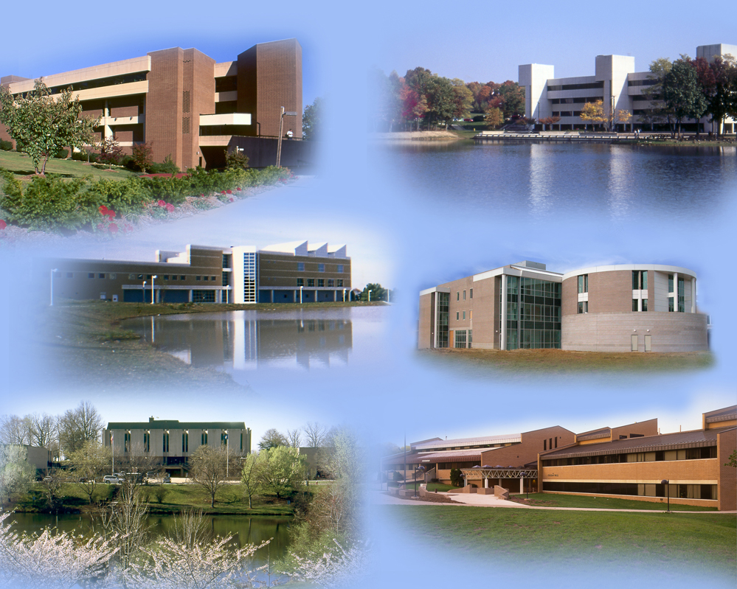
Emergency Management at NOVA: Responding to a Violent Incident

Slide 2
Virginia Tech Shooting

Slide 3
NOVA Shooting

Slide 4
Agenda
Responses to Active Incidents
Fire(evacuation)
Severe Weather
Environmental Health(MRSA &H1N1)
Faculty Responsibilities
Campus Police Responsibilities
Emergency Planning Responsibilities
Conclusion

Slide 5
Faculty Responsibilities
Faculty are the FRONT LINE!!!
Assure that appropriate announcements are made to advise students of appropriate exits
Assure that all students evacuate the building or move to the safe shelter area immediately in the event of an emergency or a drill and that doors are closed as buildings are evacuated
Familiarize yourself with your classroom; doors, telephone, windows and any first aid equipment
Notes:
.
What are the safe areas outside the buildings?

Slide 6
IMMEDIATE danger “options”
Evacuate;
Move away as far and quick as you can;
Keep objects between you and the threat;
Stay quiet and low;
Vary your direction of movement;
Once in a safe place - CALL 911
Note: Cell phone 911 should go to closest emergency communications center.
Warn others not to enter risk area;

Slide 7
IMMEDIATE danger “options”
Barricade and shelter in place;
Lock & block doors/windows;
Stay away from doors/windows;
Turn off lights;
Call 911 – maintain contact if possible;
Note who is present;
Stay calm, quiet, low, & still;
Stay sheltered until directed by Law Enforcement that all is clear

Slide 8
IMMEDIATE danger “options”
Hide:
Seek cover vs. concealment;
Lock & block doors & windows;
Stay away from doors & windows;
Turn off lights;
Call 911;
Stay calm, quiet, low, & still;

Slide 9
IMMEDIATE danger “options”
Compliance
Obey instructions;
Minimize eye contact;
Don’t challenge;
Active Resistance
Attack and disable the threat;
Continue attack until threat is stopped or you can escape.

Slide 10
Campus Police Response
Obey all commands;
Keep your hands visible at all times;
You may be handcuffed or ordered to the ground;
You will likely be searched;
Provide information to aid the response and investigation. Roll call of students
Do not leave the area without informing authorities.

Slide 11
Early Identification
Persons at risk of:
Harm to others
Harm to self
Persons who demonstrate inability to take care of themselves:
Serious mental health concerns
Substance abuse
Behavior that is significantly disruptive to the learning, living, or working environment

Slide 12
Facts About Campus Attacks
Perpetrators of serious campus violence
don’t “just snap.”
These incidents are not impulsive or random.
Most (over 75%) consider, plan, and prepare before engaging in violent behavior;
Most (over 75%) discuss their plans with others before the attack.

Slide 13
De-Escalating Situations
Do:
Stay calm;
Listen carefully & express concern;
Focus on problem-solving;
Isolate the situation but not yourself;
Be aware of non-verbal messages;
Be consistent & enforce reasonable limits.

Slide 14
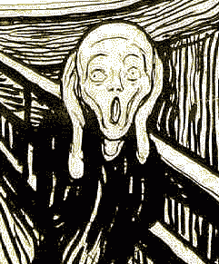
De-Escalating Situations
DO NOT:
Over-react;
Make accusations;
Be hostile or threatening;
Be defensive;
Get in a power struggle;
“Anger is one letter short of danger”

Slide 15
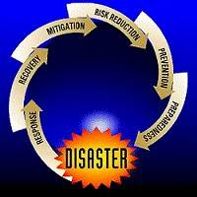
Emergency Planning
Provides Guidance and Direction in four phases of emergency management
Manages Alert Notification Policies & Procedures

Slide 16
Emergency Planning
Evaluates Hazards
Manages College Emergency Operations Center(EOC)
Serves as central coordination and communications entity for external and internal entities
Visit www.nvcc.edu/emergency for more information and to sign up for NOVA Alert

Slide 17
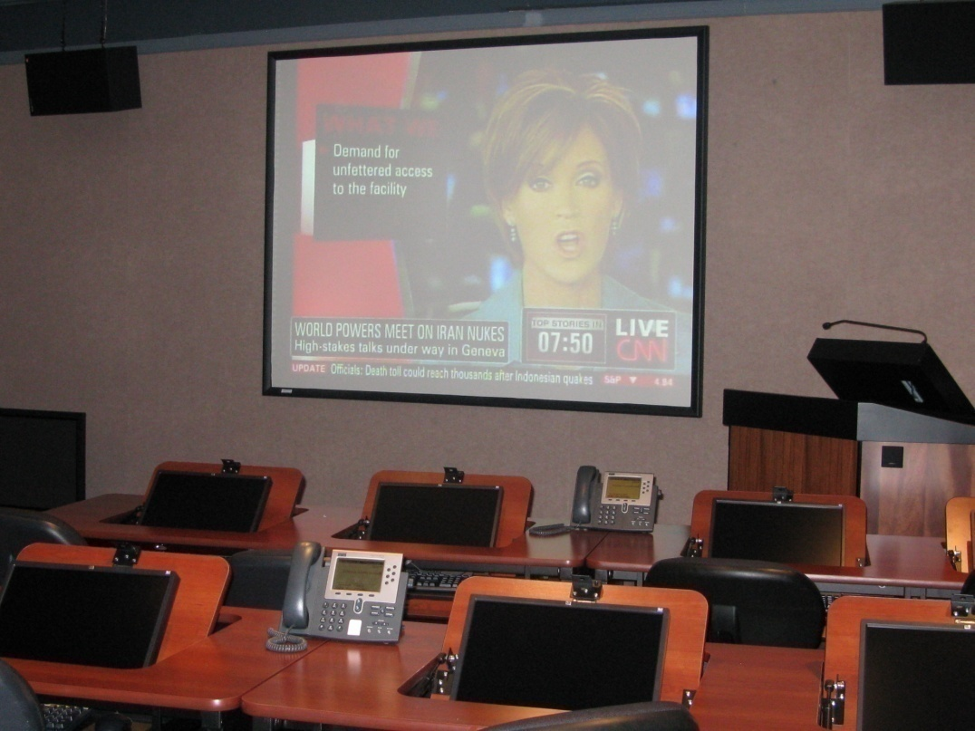
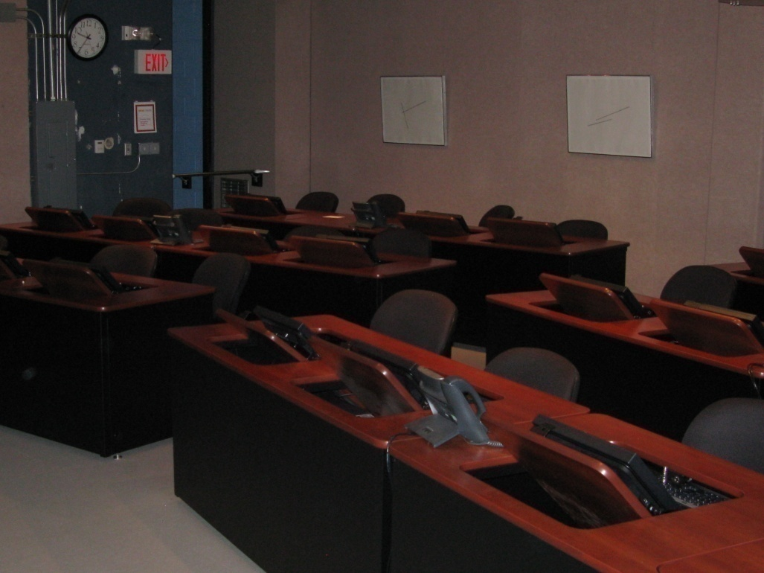
College EOC

Slide 18
Emergency Management at NOVA
Faculty
Admin Council
College Police
Public Information
Students
Staff
IT
Emergency Mgmt

Slide 19
Alert Technology at NOVA
Classroom Phones
Web site
EMAIL
Blackboard
TV CRAWL
Visual Messaging System
Pop Up Alerts
(Networked Computers)
AM Radio Transmitter
Early Warning Alert System
NOVA Connect
(Phone Messaging)
NOVA Alert (Text Messaging)
800 MHZ Radios

Slide 20
Facilitate Reporting
For reporting to be effective, people need to know:
Their role and responsibility to report
What to report
Where to report
Reports are wanted
Something will be done
Regular reminders of issues and process
“If you see something, say something.”

Slide 21
If civilization is to survive,
we must cultivate
the science of human relationships
--the ability of all people,
of all kinds, to live together,
in the same world at peace.
--- Franklin D. Roosevelt

